Slide 1
Trauma Triage Guidelines Update
2021 National Guideline for the Field Triage of Injured Pts
Adopted by WI Trauma System and WI EMS in 2022

Slide 2
National Guideline for the
Field Triage of Injured Patients

Slide 3
Presenter Name
Credentials
Affiliation
Notes:
Modifications to the PowerPoint are allowed to include the addition of local resources. Changes to the guideline graphic or any logo copyrighted by ACS are not allowed.

Slide 4
Objectives
Describe the update process
Explain the new Guideline
Discuss the changes from the 2011 Guideline
Review local & regional use of the Guideline

Slide 5
Remember
Follow your local protocol & medical director guidance

Slide 6
Why a guideline?
Achieve optimal patient outcomes through transport to most appropriate destination within the trauma system
Right Patient, Right Place, Right Time
Minimize variation in destination decisions
Notes:
For three decades, the Guideline has been widely adopted by trauma systems in the United States to support decision making by EMS clinicians in transport destination determinations for injured patients. The goal has been to ensure that seriously injured patients are transported to the most clinically appropriate trauma centers.
The Guideline helps to minimize variation in destination decisions.

Slide 7
Why an update?
New research and evidence since 2011 Guideline
Reduce time and variation in making destination decisions
Opportunity to reduce under- & over-triage
Notes:
New & updated research on field triage guidelines
Research related to the predictive utility of out-of-hospital motor Glasgow Coma Scale (GCS) score versus total GCS and other measures of mental status, circulatory measures, respiratory measures, mechanism of injury and special considerations criteria, and the overall performance of the triage guideline.
Reduction in time to making destination decision – faster to “call the trauma code”
Opportunity to reduce under-/over-triage
Under-triage is the percentage of seriously injured patients missed by field triage processes and transported to non-trauma hospitals, which is associated with increased mortality in adults and children.
Over-triage is the percentage of patients with minor to moderate injuries identified by field triage criteria as having serious injury and transported to trauma centers unnecessarily, representing overuse of limited resources and inefficiency in the system.
Under- and over-triage are inversely related and can have a large impact on ambulance transport patterns and hospital volumes.

Slide 8
Update Process
Inclusion of EMS input
  Survey distributed to 29 national organizations representing EMS and trauma
  3,958 Responses
Interdisciplinary national Expert Panel
Systematic reviews of EMS field triage and other relevant published literature
Rigorous process for adding or removing criteria
Notes:
Process has taken 2 years.
The Expert Panel included EMS clinicians, emergency physicians, trauma surgeons, nurses, EMS medical directors, EMS educators, EMS & trauma system administrators, systems experts, & representatives from stakeholder organizations.
Manuscript outlines the literature review & criteria for adding/deleting/modifying the criteria.
Survey sent to 29 national organizations with 3,958 responses received.
A statistical process for adding or removing criteria was developed by experts in predictive analytics and guideline development. The addition and removal of criterion was guided by rigorous, consistent criteria including likelihood ratios and AUROC (Area Under the Receiver Characteristic Curve).

Slide 9
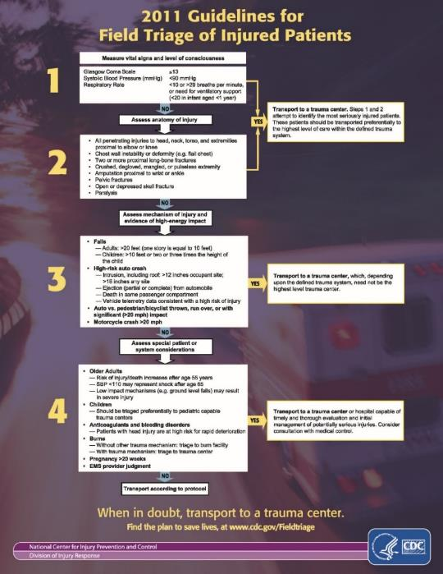
2011 Guideline
Assess vital signs & level of consciousness
Assess anatomy of injury
Assess mechanism of injury & evidence of high energy impact
Assess special patient or system considerations
Notes:
Should be familiar to all!

Slide 10
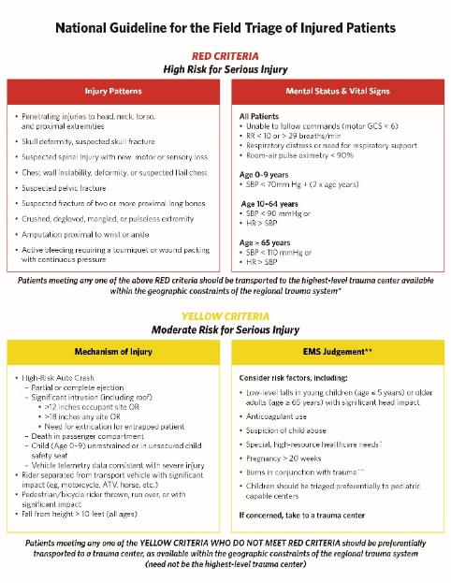
What’s new?
Not an algorithm
Simplified to align with information flow to EMS
Reflect how assessments occur on the scene
Gets to transport decision sooner
Notes:
Framework: move from algorithm of four sequential steps to two tiers based on how EMS professionals work at the scene
Characteristics:
Accessible & simple
Aligns with awareness of system capabilities
3. Gets to “yes” in trauma center disposition as quickly as possible

Slide 11
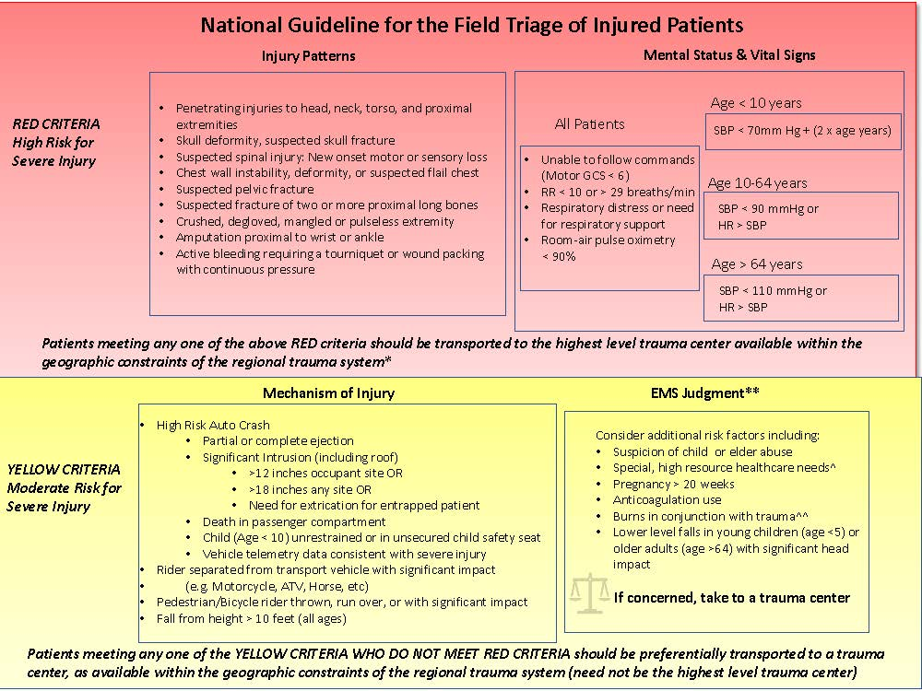
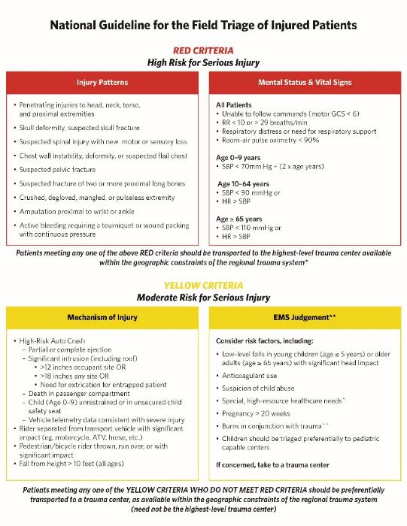
New Guideline
Flow of information to EMS
Risk
Guideline is intended to be read from left to right and top to bottom
Evidence along gradient of likelihood for serious injury
Notes:
First tier: high risk for serious injury, transport to highest level trauma center available
1. Injury patterns: rapid visual markers
2. Mental status & vital signs: physiologic indicators
Second tier: moderate risk for serious injury, transport to nearest trauma center (not necessarily the highest level)
1. Mechanism of injury
2. EMS judgment

Slide 12
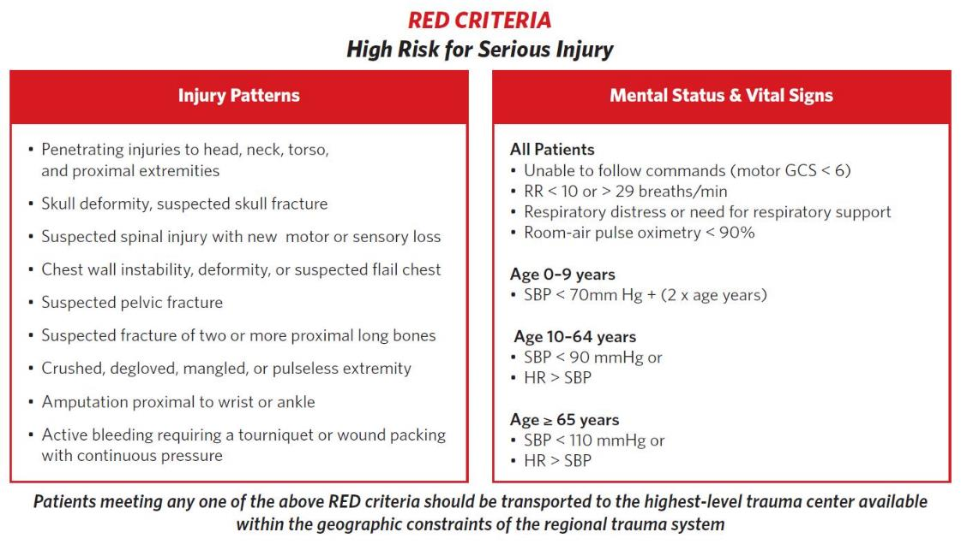
Notes:
Red category: left to right, injury patterns and mental status/vital signs
Patients to go to the highest-level care available
ALS intercept?
Air?

Slide 13
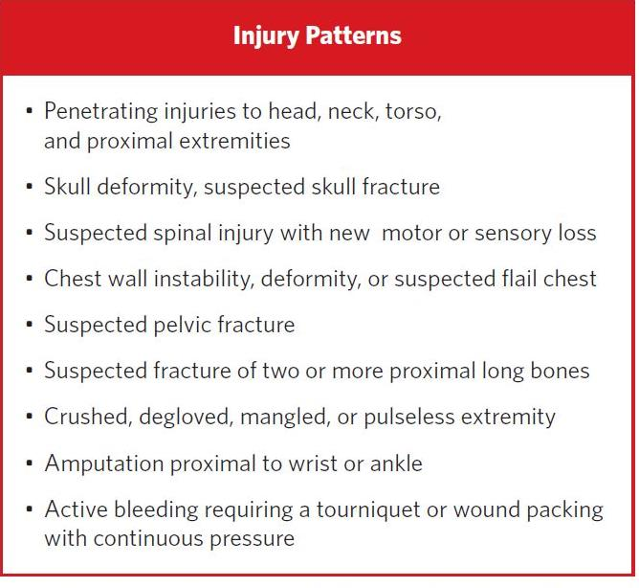
Notes:
Content – Injury Patterns
New
Active bleeding requiring a tourniquet or wound packing with continuous pressure
Clarified – re-worded
Penetrating injuries to the head, neck, torso, & proximal extremities (took out to elbow & knee)
Skull deformity, suspected skull fracture (no “open or depressed”)
Suspected spinal injury with new motor or sensory loss (instead of paralysis)
Chest wall instability, deformity or suspected flail chest (added “suspected”)
Suspected pelvic fracture (added “suspected”)
Suspected fracture of two or more proximal long bones (added “suspected”)
Retained
Crushed, degloved, mangled, or pulseless extremity
Amputation proximal to wrist or ankle

Slide 14

Age-related changes to vital signs have been added
Source: Getty Images. Used with permission
Notes:
Rather than one set of vital signs, there are now different sets for adult, pediatric, and geriatric. These are outlined on the next slide.

Slide 15
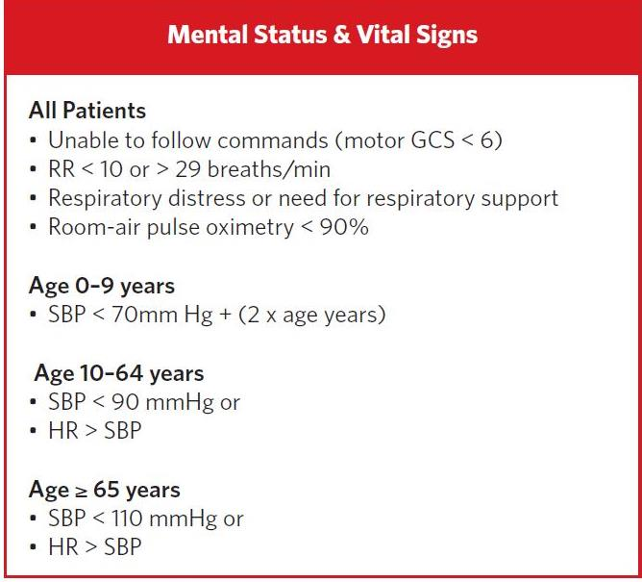
Notes:
New
Heart rate > SBP for adults
Respiratory distress or need for respiratory support
Room-air pulse oximetry < 90 mmHg
Modified
Motor GCS < 6 (was overall less than 13 but now no calculations needed. “Can you look at me?” If they can, passes, if not – transport)
SBP < 70 mmHg + (2 x age), for children 0-9 years (added as different from adult)
Retained
SBP < 90 mmHg & < 110 in older adults
RR < 10 or > 29 breaths/minute

Slide 16
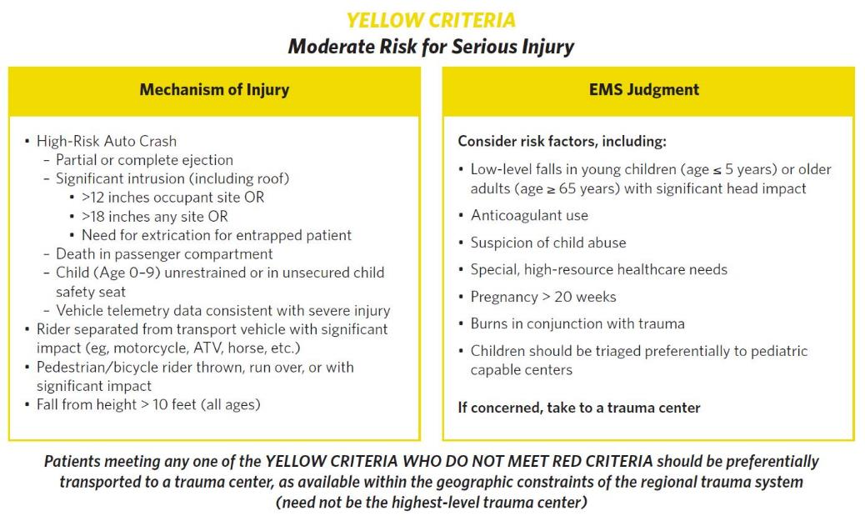
Notes:
Yellow category: left to right, starts with mechanism of injury and proceeds to EMS judgment
Patients to go to the nearest trauma center

Slide 17
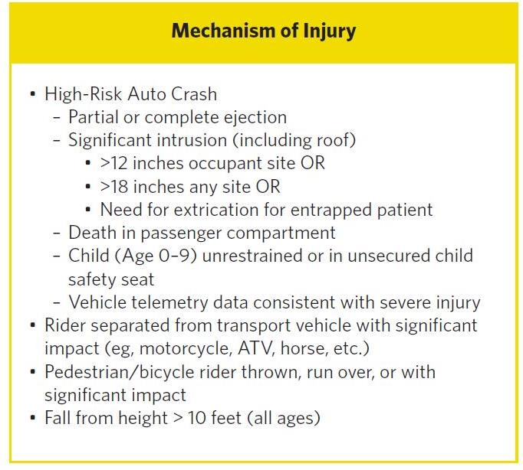
Extrication relates to entrapment, not simple confinement
Notes:
New
Child (Age 0-9 years) unrestrained or in unsecured child safety seat
Modified
Significant intrusion (including roof) > 12 inches occupant site or > 18 inches any site or need for extrication of the entrapped patient (added extrication)
“Extrication” does not include simple confinement. For example, cutting a post or popping a door to gain access for an otherwise stable patient who is unable to open a door is NOT extrication. Extrication here is more complex involving time greater than 5 minutes and/or impingement on the patient. Entrapment is not confinement.
Rider separated from transport vehicle – not just “ejection from automobile”
Fall from height > 10 feet (all ages now instead of different heights or “times the height of…”)
Clarified: pedestrian/Bicycle rider thrown, run over, or with significant impact (no speed limit)
Retained
Ejection (partial or complete) from automobile
Death in passenger compartment
Vehicle telemetry data consistent with severe injury

Slide 18
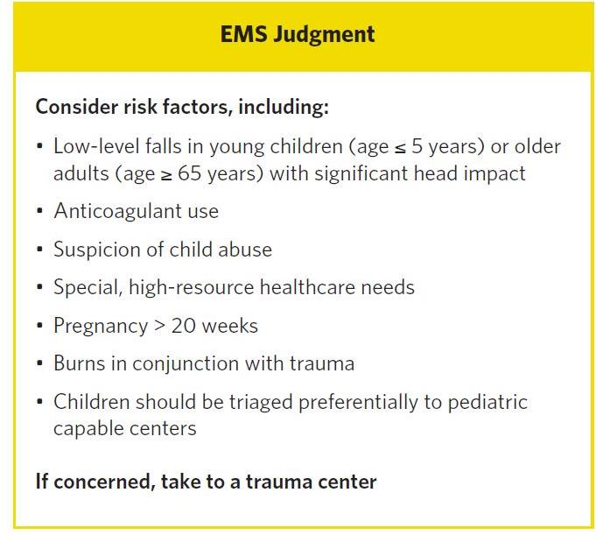
Notes:
New
Low level falls in young children (age ≤ 5 years) or older adults (age ≥ 65 years) with significant head impact
Suspicion of child abuse
Special, high resource healthcare needs
Modified
Anticoagulation use (all trauma, not just head injuries)
Retained
Pregnancy > 20 weeks
Burns in conjunction with trauma
Children should be triaged preferentially to pediatric capable trauma centers
As always, if concerned take to a trauma center

Slide 19
Applying the Guideline
Appreciate and understand the context
Know your local and regional trauma resources
Encourage adoption by local and state EMS agencies
Sustain education and training
Track use and outcomes through performance improvement
Notes:
Appreciate the context
Not for mass casualties
This is a field triage guideline for prehospital use
Know your local and regional trauma resources
What are the possible patient destinations and trauma capabilities?
Encourage adoption by local and state EMS agencies
Sustain education and training
Individual & group initial training on the new guideline
Use posters, protocols, & badge cards
Refresh knowledge as part of your continuing education
Track use and outcomes through performance improvement
Review over- & under-triage by criteria
Inform sustainment training

Slide 20
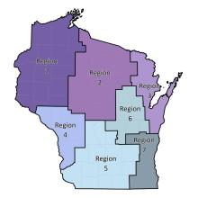
Encourage Adoption
Notes:
Encourage adoption by local & state EMS agencies, as well as regional & state trauma systems
Get everyone on the same page!

Slide 21
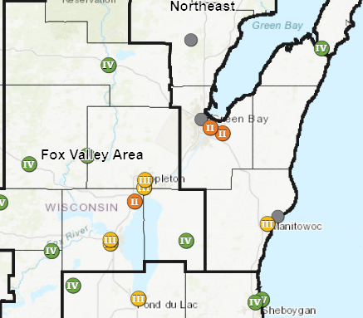
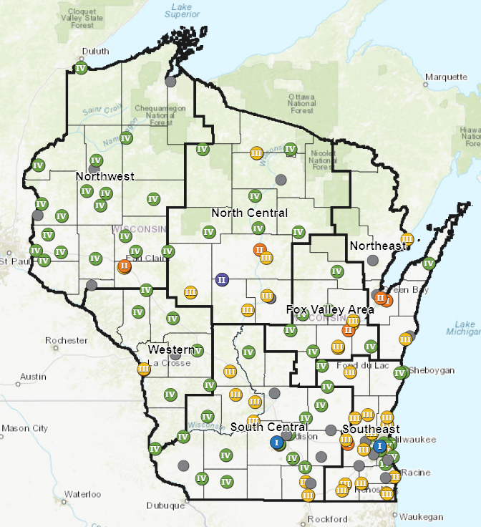
Local & Regional Resources
Notes:
Discuss local trauma centers, designations (differences), & capabilities
May have state map with distance to trauma centers

Slide 22
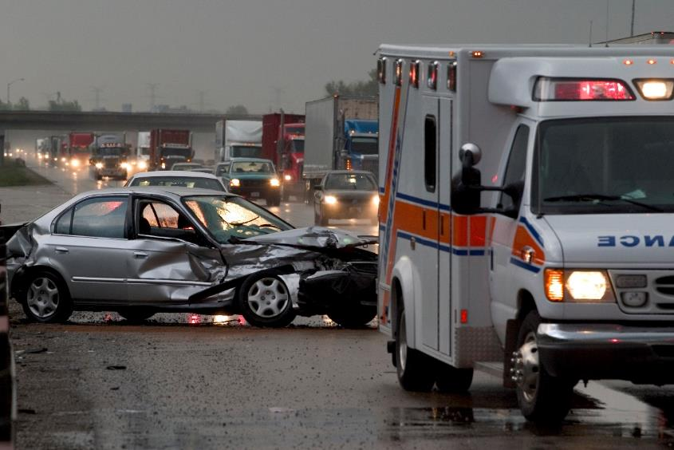
Transport According to Local Protocol
Source: Getty Images. Used with permission
Notes:
Discuss local protocol or state guidelines/requirements for EMS transport plans

Slide 23

ALS Intercepts & Air Assets
Notes:
Discuss local protocols on ALS intercepts & air activation. How does this guideline impact those?
When will these services auto-deploy in your area?

Slide 24
Summary
Update process inclusive of EMS clinician input
New guideline aligns with information flow to EMS and how assessments occur on the scene
Guideline use is best assessed through impact on under- & over-triage rates

Slide 25
Questions?
Notes:
May add presenter contact info as appropriate

Slide 26
Case-Based
Triage Scenarios
Target Audience: New EMS Clinicians

Slide 27
These case-based scenarios have been developed as an educational training tool to illustrate application of the National Guideline for the Field Triage of Injured Patients.
EMS and trauma systems vary significantly across the US. These cases include hypothetical system resources from a mix of urban, suburban, and rural community scenarios. Attention should be given to how the availability of different resources may influence your decision making.
Notes:
INSTRUCTORS:
Multiple case scenarios have been developed to facilitate education and training to apply the National Field Triage Guideline in practice. Covering all cases is not necessary depending on time constraints; it is recommended to cover at least 3-5 cases. Choose a variety of cases that cover Injury Patterns, Mental Status & Vital Signs, Mechanism of Injury, & EMS Judgment criteria from the Guideline to illustrate how each set of criteria is applied to injured patients.
These patient cases and discussion points include a mix of urban, suburban, and rural settings and resources for you and the trainees to consider when making triage decisions.
It is important to discuss how system resources can impact triage decision making, including bypassing other hospitals, selection of the level of trauma center, and/or use of air medical transport.
The cases contain the ABCD primary survey and secondary survey to clarify if a patient does or does not meet the specific criterion.

Slide 28
In each scenario there will be one patient to assess and make a triage decision.
The Field Triage Guideline was developed using the best available evidence to identify patients that are most likely to benefit from the resources of a trauma center. They are not meant to supersede local trauma triage protocols and are not intended for mass casualty incident (MCI) triage.
Notes:
INSTRUCTORS:
Multiple case scenarios have been developed to facilitate education and training to apply the National Field Triage Guideline in practice. Covering all cases is not necessary depending on time constraints; it is recommended to cover at least 3-5 cases. Choose a variety of cases that cover Injury Patterns, Mental Status & Vital Signs, Mechanism of Injury, & EMS Judgment criteria from the Guideline to illustrate how each set of criteria is applied to injured patients.
These patient cases and discussion points include a mix of urban, suburban, and rural settings and resources for you and the trainees to consider when making triage decisions.
It is important to discuss how system resources can impact triage decision making, including bypassing other hospitals, selection of the level of trauma center, and/or use of air medical transport.
The cases contain the ABCD primary survey and secondary survey to clarify if a patient does or does not meet the specific criterion.

Slide 29
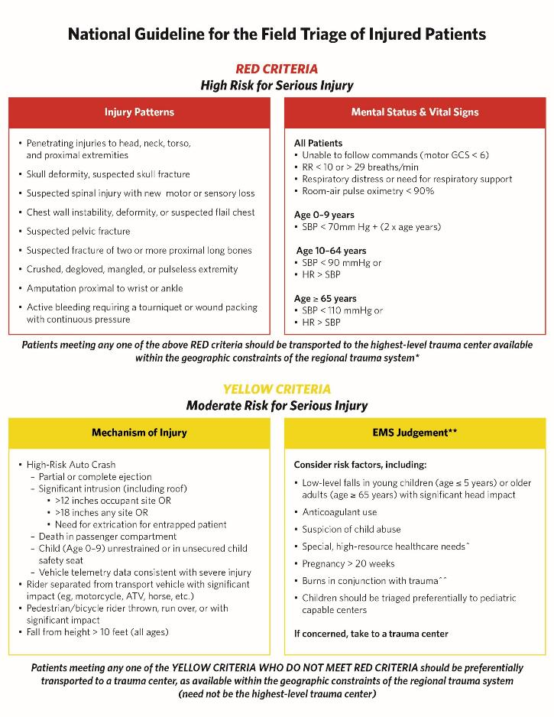
Notes:
INSTRUCTORS:
If you have not already, review the Field Triage Guidelines here.

Slide 30
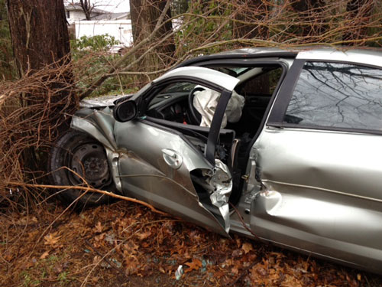
Valders Case 2a
System & Resources: Rural transport ambulance. Level II trauma center 30-40 min transport, Level III trauma center 20 min transport, community hospital 20 min transport. Air transport on scene 20 min from request.
Dispatch Info: Two-car MVC, one car over embankment. You and a second unit are dispatched.
Scene Size Up: Sedan over embankment, damage as shown. Young female restrained driver responding but confined by damaged door. Air bags deployed. Door is popped by rescue & patient able to self-extricate.
Primary survey:
A – Yelling for help, answers questions
B – Regular, non-laboredwing commands,
agitated about wreck
112/68 HR 96 RR 18 SpO2 99% RA GCS 15
History – None
Initial Thoughts?
Source: Mark Gestring, MD FACS. Used with permission
Notes:
Discussion Points:
Criterion demonstrated – Need for extrication for entrapped patient → YELLOW criteria, should go to trauma center not necessarily highest level available (if no RED criteria met)
Patient does NOT meet this criterion, does not need a trauma center if no other criteria met. Popping a door does not rise to level of extrication for entrapment.
System & resource considerations – Can transport to closest hospital or hospital of patient’s choice
Bypass other centers – Not applicable, unless per patient choice
Patient destination – Community hospital
Transport mode – Ground

Slide 31

Case 2a
System & Resources: Rural transport ambulance. Level II trauma center 30-40 min transport, Level III trauma center 20 min transport, community hospital 20 min transport. Air transport on scene 20 min from request.
Dispatch Info: Two-car MVC, one car over embankment. You and a second unit are dispatched.
Scene Size Up: Sedan over embankment, damage as shown. Young female restrained driver responding but confined by damaged door. Air bags deployed. Door is popped by rescue & patient able to self-extricate.
Primary Survey:
A – Yelling for help, answers questions
B – Regular, non-labored
C – Regular radial pulse, warm skin
D – Following commands, agitated about wreck
Secondary survey:
Exam – Scattered
small facial & arm lacs from glass, obviously deformed right shin with bruisin
Patient Destination?
Source: Mark Gestring, MD FACS. Used with permission
Notes:
Discussion Points:
Criterion demonstrated – Need for extrication for entrapped patient → YELLOW criteria, should go to trauma center not necessarily highest level available (if no RED criteria met)
Patient does NOT meet this criterion, does not need a trauma center if no other criteria met. Popping a door does not rise to level of extrication for entrapment.
System & resource considerations – Can transport to closest hospital or hospital of patient’s choice
Bypass other centers – Not applicable, unless per patient choice
Patient destination – Community hospital
Transport mode – Ground

Slide 32
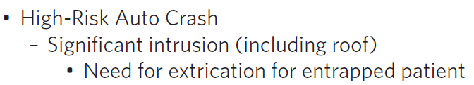
Case 2a
System & Resources: Rural transport ambulance. Level II trauma center 30-40 min transport, Level III trauma center 20 min transport, community hospital 20 min transport. Air transport on scene 20 min from request.
Dispatch Info: Two-car MVC, one car over embankment. You and a second unit are dispatched.
Scene Size Up: Sedan over embankment, damage as shown. Young female restrained driver responding but confined by damaged door. Air bags deployed. Door is popped by rescue & patient able to self-extricate.
Primary Survey:
A – Yelling for help, answers questions
B – Regular, non-labored
C – Regular radial pulse, warm skin
D – Following commands, agitated about wreck
Secondary Survey:
Exam – Scattered small facial & arm lacs from glass, bilateral shins with bruising
Initial vital signs – BP 112/68 HR 96 RR 18 SpO2 99% RA GCS M 6
History – None
Changes to Your Plan?
Source: Mark Gestring, MD FACS. Used with permission
Notes:
Discussion Points:
Criterion demonstrated – Need for extrication for entrapped patient → YELLOW criteria, should go to trauma center not necessarily highest level available (if no RED criteria met)
Patient does NOT meet this criterion, does not need a trauma center if no other criteria met. Popping a door does not rise to level of extrication for entrapment.
System & resource considerations – Can transport to closest hospital or hospital of patient’s choice
Bypass other centers – Not applicable, unless per patient choice
Patient destination – Community hospital
Transport mode – Ground

Slide 33
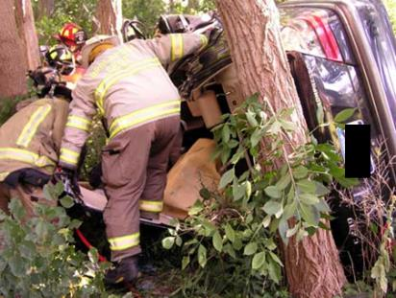
Valders Case 2b
System & Resources: Rural transport ambulance. Level II trauma center 30-40 min transport, Level III trauma center 20 min transport, community hospital 20 min transport. Air transport on scene 20 min from request.
Dispatch Info: Two-car MVC, one car over embankment. You and a second unit are dispatched.
Scene Size Up: Sedan over embankment resting on side as shown. Young female restrained driver responding but lower extremities entrapped under dash. Rescue removes the roof and performs dash roll to extricate patient, takes ~25 minutes to get patient out.
Primary survey:
A – Yelling for help, answers questions
B – Regular, non-labored
C – Regular radial pulse, warm skin
D – Following comma
nds, agitated about wreck
99% RA GCS 15
History – None
Initial Thoughts?
Source: Mark Gestring, MD FACS. Used with permission
Notes:
Discussion Points:
Criterion demonstrated – Need for extrication for entrapped patient → YELLOW criteria, should go to trauma center not necessarily highest level available (if no RED criteria met)
This level of extrication does meet the extrication for entrapment criterion and is associated with a high risk of severe injury. The patient should be taken to a trauma center.
System & resource considerations – Patient with YELLOW criterion can go to lower-level trauma center, Level IV trauma center is closest.
Bypass other centers – Community hospital
Patient destination – Level IV trauma center
Transport mode – Ground

Slide 34
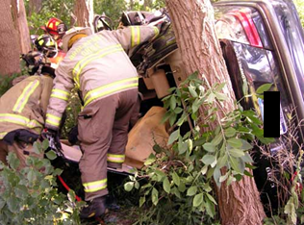
Case 2b
System & Resources: Rural transport ambulance. Level II trauma center 30-40 min transport, Level III trauma center 20 min transport, community hospital 20 min transport. Air transport on scene 20 min from request.
Dispatch Info: Two-car MVC, one car over embankment. You and a second unit are dispatched.
Scene Size Up: Sedan over embankment resting on side as shown. Young female restrained driver responding but lower extremities entrapped under dash. Rescue removes the roof and performs dash roll to extricate patient, takes ~25 minutes to get patient out.
Primary Survey:
A – Yelling for help, answers questions
B – Regular, non-labored
C – Regular radial pulse, warm skin
D – Following commands, agitated about wreck
deformed right shin with bruising
Initial vital signs – BP 112/68 HR 96 RR 18 SpO2 99% RA GCS 15
History – None
Patient Destination?
Source: Mark Gestring, MD FACS. Used with permission
Notes:
Discussion Points:
Criterion demonstrated – Need for extrication for entrapped patient → YELLOW criteria, should go to trauma center not necessarily highest level available (if no RED criteria met)
This level of extrication does meet the extrication for entrapment criterion and is associated with a high risk of severe injury. The patient should be taken to a trauma center.
System & resource considerations – Patient with YELLOW criterion can go to lower-level trauma center, Level IV trauma center is closest.
Bypass other centers – Community hospital
Patient destination – Level IV trauma center
Transport mode – Ground

Slide 35
Case 2b
System & Resources: Rural transport ambulance. Level II trauma center 30-40 min transport, Level III trauma center 20 min transport, community hospital 20 min transport. Air transport on scene 20 min from request.
Dispatch Info: Two-car MVC, one car over embankment. You and a second unit are dispatched.
Scene Size Up: Sedan over embankment resting on side as shown. Young female restrained driver responding but lower extremities entrapped under dash. Rescue removes the roof and performs dash roll to extricate patient, takes ~25 minutes to get patient out.
Primary Survey:
A – Yelling for help, answers questions
B – Regular, non-labored
C – Regular radial pulse, warm skin
D – Following commands, agitated about wreck
Secondary Survey:
Exam – Scattered small facial & arm lacs from glass, bilateral shins with bruising
Initial vital signs – BP 112/68 HR 96 RR 18 SpO2 99% RA GCS M 6
History – None
Changes to Your Plan?
Source: Mark Gestring, MD FACS. Used with permission
Notes:
Discussion Points:
Criterion demonstrated – Need for extrication for entrapped patient → YELLOW criteria, should go to trauma center not necessarily highest level available (if no RED criteria met)
This level of extrication does meet the extrication for entrapment criterion and is associated with a high risk of severe injury. The patient should be taken to a trauma center.
System & resource considerations – Patient with YELLOW criterion can go to lower-level trauma center, Level IV trauma center is closest.
Bypass other centers – Community hospital
Patient destination – Level IV trauma center
Transport mode – Ground

Slide 36
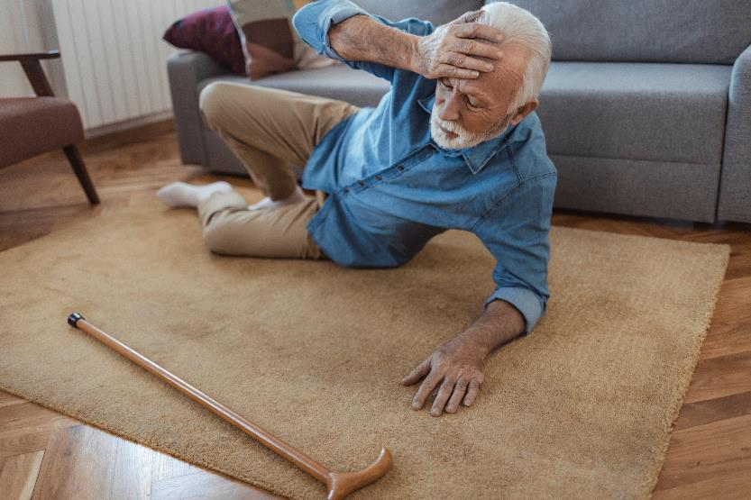
Valders Case 4b
System & Resources: Rural transport ambulance. Level II trauma center 30-40 min transport, Level III trauma center 20 min transport, community hospital 20 min transport. Air transport on scene 20 min from request.
Dispatch Info: Elderly male ground level fall.
Scene Size Up: Elderly male lying on ground near couch. Lives alone.
Primary survey:
A – Answers questions
B – Regular, non-labored
C – Regular radial pulse, warm skin
D – Following commands, oriented to person, place. States he tripped on rug
Secondary survey:
Exam – Large hematoma on left forehead with small overlying skin tear. Multiple bruises on both arms, some appear old.Coumadin)
Initial Thoughts?
Source: Getty Images. Used with permission
Notes:
Discussion Points:
Criterion demonstrated – EMS Judgment: additional risk factors of lower level fall in older adult with significant head impact + Anticoagulation use → YELLOW criteria, should go to trauma center not necessarily highest level available (if no RED criteria met)
Multiple additional risk factors including anticoagulation in setting of evidence of significant head impact. Likely patients should be taken to a trauma center.
System & resource considerations – Level II is closest trauma center, with YELLOW criteria, do not need to transport to farther Level I trauma center.
Bypass other centers – Community hospital
Patient destination – Level II trauma center
Transport mode – Ground

Slide 37

Case 4b
System & Resources: Rural transport ambulance. Level II trauma center 30-40 min transport, Level III trauma center 20 min transport, community hospital 20 min transport. Air transport on scene 20 min from request.
Dispatch Info: Elderly male ground level fall.
Scene Size Up: Elderly male lying on ground near couch. Lives alone.
Primary Survey:
A – Answers questions
B – Regular, non-labored
C – Regular radial pulse, warm skin
D – Following commands, oriented to person, place. States he tripped on rug
Secondary survey:
Patient Destination?
Source: Getty Images. Used with permission
Notes:
Discussion Points:
Criterion demonstrated – EMS Judgment: additional risk factors of lower level fall in older adult with significant head impact + Anticoagulation use → YELLOW criteria, should go to trauma center not necessarily highest level available (if no RED criteria met)
Multiple additional risk factors including anticoagulation in setting of evidence of significant head impact. Likely patients should be taken to a trauma center.
System & resource considerations – Level II is closest trauma center, with YELLOW criteria, do not need to transport to farther Level I trauma center.
Bypass other centers – Community hospital
Patient destination – Level II trauma center
Transport mode – Ground

Slide 38

Case 4b
System & Resources: Rural transport ambulance. Level II trauma center 30-40 min transport, Level III trauma center 20 min transport, community hospital 20 min transport. Air transport on scene 20 min from request.
Dispatch Info: Elderly male ground level fall.
Scene Size Up: Elderly male lying on ground near couch. Lives alone.
Primary Survey:
A – Answers questions
B – Regular, non-labored
C – Regular radial pulse, warm skin
D – Following commands, oriented to person, place. States he tripped on rug
Secondary Survey:
Exam – Large hematoma on left forehead with small overlying skin tear. Multiple bruises on both arms, some appear old.
Initial vital signs – BP 168/84 HR 84 RR 12 SpO2 96% RA GCS M 6
History – CAD, HTN, OA, afib. On warfarin (Coumadin)
Changes to Your Plan?
Source: Getty Images. Used with permission
Notes:
Discussion Points:
Criterion demonstrated – EMS Judgment: additional risk factors of lower level fall in older adult with significant head impact + Anticoagulation use → YELLOW criteria, should go to trauma center not necessarily highest level available (if no RED criteria met)
Multiple additional risk factors including anticoagulation in setting of evidence of significant head impact. Likely patients should be taken to a trauma center.
System & resource considerations – Level II is closest trauma center, with YELLOW criteria, do not need to transport to farther Level I trauma center.
Bypass other centers – Community hospital
Patient destination – Level II trauma center
Transport mode – Ground

Slide 39

Valders Case 6
System & Resources: Rural transport ambulance. Level II trauma center 30-40 min transport, Level III trauma center 20 min transport, community hospital 20 min transport. Air transport on scene 20 min from request.
Dispatch Info: Male fell off ladder.
Scene Size Up: Middle aged male lying supine on concrete driveway, ladder lying next to him near 2 story roof.
Initial Thoughts?
Source: Getty Images. Used with permission
Notes:
Discussion Points:
Criterion demonstrated –
1. Fall from height >10 feet (all ages) → YELLOW criteria, should go to trauma center not necessarily highest level available (if no RED criteria met)
2. Suspected spinal injury: New onset motor or sensory loss → RED criterion, should go to highest level trauma center available
System & resource considerations – Patient should go to the highest level of trauma center available because of the suspected spinal injury with inability to move his legs after the fall. He meets both a RED criterion and YELLOW criterion, and the RED criteria supersedes the YELLOW criterion for destination determination. Highest level trauma center relatively far, consider Air transport availability and potential need for mutual aid if transport ground to Level I trauma center
Bypass other centers – Community hospital and Level III trauma center (especially if Air transport available)
Patient destination – Level I trauma center. Patient may need to go to Level III depending on conditions, such as unavailability of Air transport and/or mutual aid EMS coverage.
Transport mode – Air transport to level I, can Ground transport to Level I if system resources support. Possibly ground to level III if Air transport unavailable and already using mutual aid for additional 911 call coverage.

Slide 40
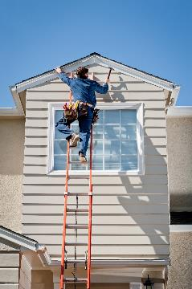
Case 6
System & Resources: Rural transport ambulance. Level II trauma center 30-40 min transport, Level III trauma center 20 min transport, community hospital 20 min transport. Air transport on scene 20 min from request.
Dispatch Info: Male fell off ladder.
Scene Size Up: Middle aged male lying supine on concrete driveway, ladder lying next to him near 2 story roof.
Primary Survey:
A – Answers questions
B – Regular, non-labored
C – Regular radial pulse, warm skin
D – Following commands. States up working on roof eaves and ladder gave out.
Patient Destination?
Source: Getty Images. Used with permission
Notes:
Discussion Points:
Criterion demonstrated –
1. Fall from height >10 feet (all ages) → YELLOW criteria, should go to trauma center not necessarily highest level available (if no RED criteria met)
2. Suspected spinal injury: New onset motor or sensory loss → RED criterion, should go to highest level trauma center available
System & resource considerations – Patient should go to the highest level of trauma center available because of the suspected spinal injury with inability to move his legs after the fall. He meets both a RED criterion and YELLOW criterion, and the RED criteria supersedes the YELLOW criterion for destination determination. Highest level trauma center relatively far, consider Air transport availability and potential need for mutual aid if transport ground to Level I trauma center
Bypass other centers – Community hospital and Level III trauma center (especially if Air transport available)
Patient destination – Level I trauma center. Patient may need to go to Level III depending on conditions, such as unavailability of Air transport and/or mutual aid EMS coverage.
Transport mode – Air transport to level I, can Ground transport to Level I if system resources support. Possibly ground to level III if Air transport unavailable and already using mutual aid for additional 911 call coverage.

Slide 41
Case 6
System & Resources: Rural transport ambulance. Level II trauma center 30-40 min transport, Level III trauma center 20 min transport, community hospital 20 min transport. Air transport on scene 20 min from request.
Dispatch Info: Male fell off ladder.
Scene Size Up: Middle aged male lying supine on concrete driveway, ladder lying next to him near 2 story roof.
Primary Survey:
A – Answers questions
B – Regular, non-labored
C – Regular radial pulse, warm skin
D – Following commands. States up working on roof eaves and ladder gave out.
Secondary Survey:
Exam – Hematoma to occiput. Cannot move lower extremities, states they are numb. Full strength in upper extremities. No obvious lower extremity deformities.
Initial vital – BP 152/110 HR 70 RR 22 SpO2 98% RA GCS M 6
History – HTN, CAD, CABGx2
Changes to Your Plan?
Source: Getty Images. Used with permission
Notes:
Discussion Points:
Criterion demonstrated –
1. Fall from height >10 feet (all ages) → YELLOW criteria, should go to trauma center not necessarily highest level available (if no RED criteria met)
2. Suspected spinal injury: New onset motor or sensory loss → RED criterion, should go to highest level trauma center available
System & resource considerations – Patient should go to the highest level of trauma center available because of the suspected spinal injury with inability to move his legs after the fall. He meets both a RED criterion and YELLOW criterion, and the RED criteria supersedes the YELLOW criterion for destination determination. Highest level trauma center relatively far, consider Air transport availability and potential need for mutual aid if transport ground to Level I trauma center
Bypass other centers – Community hospital and Level III trauma center (especially if Air transport available)
Patient destination – Level I trauma center. Patient may need to go to Level III depending on conditions, such as unavailability of Air transport and/or mutual aid EMS coverage.
Transport mode – Air transport to level I, can Ground transport to Level I if system resources support. Possibly ground to level III if Air transport unavailable and already using mutual aid for additional 911 call coverage.

Slide 42
You have seen how resource availability can impact triage, patient destination, and transport mode decisions.
It is important to understand the local EMS and trauma system resources where you practice.
Trauma centers of each level and transport time/distance
Local non-trauma center hospitals
Air medical services and time to request & arrive on scene
Other ambulance coverage & need for mutual aid
Geographic constraints or other unique resources and challenges
Notes:
INSTRUCTORS:
Emphasize, particularly for new trainees, that it will be important to understand the system they ultimately practice in. The resources may include trauma centers of different levels, non-trauma center hospitals, air medical transport resources, other EMS coverage, or need for mutual aid. Additionally, it is important to consider geographic constraints or other challenges unique to the EMS and trauma system.

