Slide 1
Sports Related Injuries including Prehospital Traumatic Brain Injuries and Commotio Cordis
Kiel Ambulance Training Series in partnership with Aurora Sports Medicine Athletic Trainer

Slide 2
Sports Related Injuries
According to a John Hopkins study there are about 30 million children and teenagers who participate in organized sports annually. An out of those 30 million participants, injuries occur to more than 3.5 million athletes or 12%.
Although 12% may seem like a small number, sports related injuries contribute to 21% of all traumatic brain injuries in youth.
Contact sports remain the highest type of athletic activity to cause injuries. Baseball has the highest fatality rate in youth sports.

Slide 3
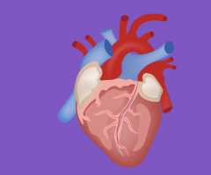
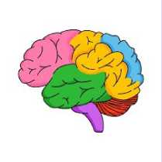
Two areas of focus tonight are
Commotio Cordis
Traumatic Brain Injuries

Slide 4

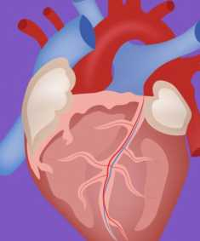
Commotio Cordis

Slide 5
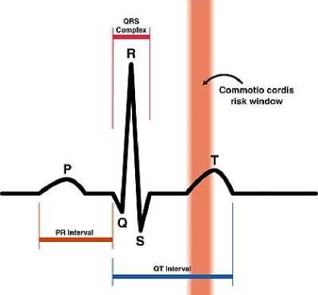
Commotio Cordis
Commotio cordis is a rare event that occurs when blunt force is taken to the chest during a specific point in the cardiac cycle. If rapid treatment is not provided, commotio cordis has a 97% fatality rate.

Slide 6
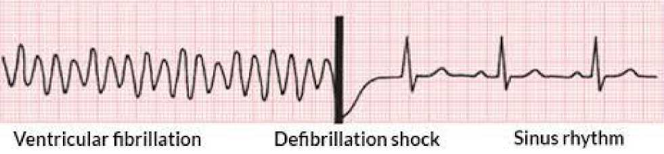
Commotio Cordis
Ventricular fibrillation (v-fib) is the most common cardiac arrhythmia caused during commotio cordis, and rapid defibrillation required to restore normal cardiac electrical activity.

Slide 7
Commotio Cordis -EMS
Prehospital treatment of commotio cordis starts with early recognition and fast defibrillation.
Standard resuscitation protocols or post resuscitation protocols should be followed.
Rapid transport to an appropriate cardiac center is preferred. This is a scenario when air medical should be considered.
*Remember to take into consideration potential c-spine injuries.

Slide 8
Commotio Cordis -EMS

Slide 9

Traumatic Brain Injuries

Slide 10
Traumatic Brain Injuries
A traumatic brain injury (TBI) is when there is a sudden external physical assault, that damages the brain. The damage can be focal (one area of the brain) and diffuse (multiple areas of the brain).
Severity can range from a mild concussion to bleeding to coma and death.

Slide 11
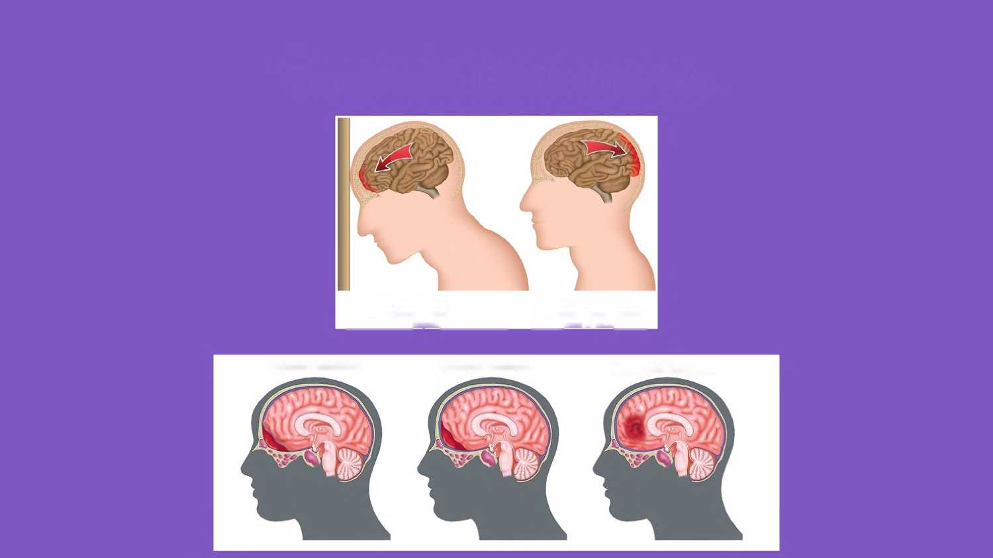
Traumatic Brain Injuries
1. Primary Impact - Coup The brain strikes the skull on the side of ________________impact.________________
2. Secondary Impact -Contrecoup Impact posterior ________area of skull._________
Epidural Hematoma
Subdural Hematoma
Intracranial Hematoma

Slide 12
Traumatic Brain Injuries
Primary Brain Injury Secondary Brain Injury
❖ Definition - Damage to the brain from the biomechanical effects of the trauma, causing:
• Ischemia
• Anoxia/hypoxia or
• Shear injury
❖ Definition - The result of one or more of the following:
• Hypoxia
• Hypotension (decreased cerebral blood flow)
• Increased intracranial pressure (ICP)
• Hyper- or hypoglycemia
• Metabolic disturbances
• Seizures

Slide 13
Traumatic Brain Injuries Signs and Symptoms
Loss of consciousness
Appears dazed and confused
Confusion
Slow to move or answer questions
Balance problems
Nausea and/or vomiting
Dizziness
Sensitivity to light or noise
Concentration or memory problems
Unable to recall recent event
Headache or head pressure
Does not feel right

Slide 14
Traumatic Brain Injuries
Avoid the three “H” Bombs
Hypoxia
Hypotension
Hyperventilation

Slide 15
Traumatic Brain Injuries
Respiratory:
Assess rate, depth, quality, and effectiveness of ventilation every 5 minutes and as needed
❖ Hypoxia occurs in 40% of severe TBI
❖ Assess for hypoxia
❖ Important indicators of hypoxia:
• SpO2 < 90%
• Central cyanosis

Slide 16
Traumatic Brain Injuries
Hyperventilation produces a rapid decrease in the arterial partial pressure of carbon dioxide, which causes cerebral vasoconstriction, decreased cerebral blood flow, and lower intracranial pressure (ICP), giving the brain more room to swell.
• Hyperventilation can decrease the cerebral blood flow, potentially to the point of ischemia.
❖ Take Home Message: Monitor End-Tidal CO2 closely if capnography is available.

Slide 17
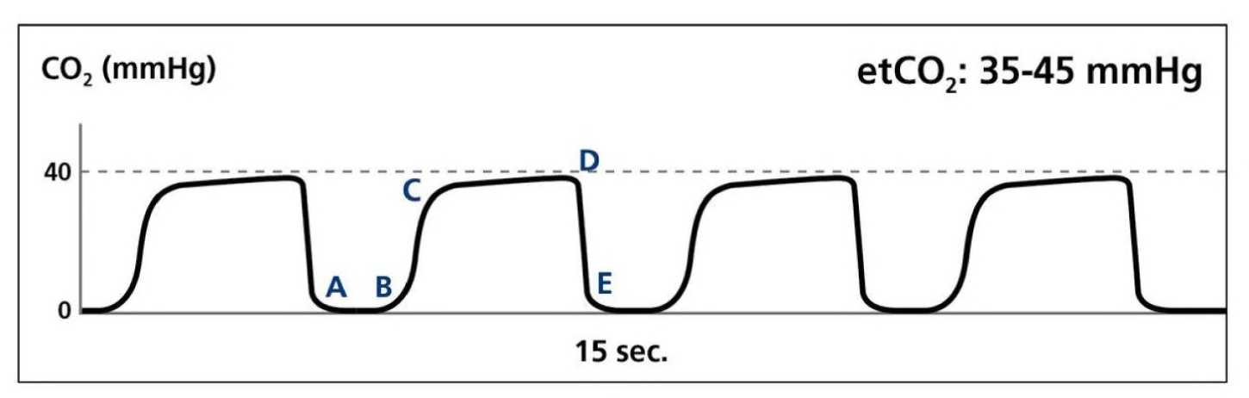
Traumatic Brain Injuries

Slide 18
Traumatic Brain Injuries
Research identifies potential harm that can come from hyperventilating a TBI patient without signs of brain herniation (posturing, unresponsive, respiratory arrest)
• Hyperventilation is a short term measure used in specific severe TBI patients (herniation) until definitive diagnostic or therapeutic interventions can be initiated.

Slide 19
Traumatic Brain Injuries
Circulation:
❖ Look for visible signs of “shock”
❖ Assess SBP every 5 minutes & as needed
• Adult critical threshold level < 90 mm Hg
• Child and infant levels are lower
• Use age/size appropriate BP cuff

Slide 20
Traumatic Brain Injuries
Circulation:
❖ Look for visible signs of “shock”
• Cool, clammy skin
• Rapid shallow respirations
• Rapid weak or irregular pulse
• Confusion
• Low blood pressure
❖ Assess SBP every 5 minutes & as needed
• Adult critical threshold level < 90 mm Hg
• Child and infant levels are lower
• Use age/size appropriate BP cuff

Slide 21
Traumatic Brain Injuries
❖ Any episode of hypotension can worsen outcome from TBI.
❖ A decrease in mean arterial pressure (MAP) can decrease cerebral blood flow and cerebral perfusion pressure.
❖ Systolic BP is used as an indicator of MAP in prehospital care
MAP= ((2x diastolic)+systolic)/3 Normal range is 70-110
Take Home Message: Maintaining Blood Pressure is Critical

Slide 22
Traumatic Brain Injuries
Treatment:
❖ Protect C-spine alignment, consider facial trauma
❖ Document GCS
❖ Airway support per scope of practice
❖ Intubate severe TBI patients
❖ Correct hypoxia

Slide 23
Traumatic Brain Injuries
❖ The goal is to maintain normotension and adequate tissue perfusion.
❖ A single episode of hypotension doubles mortality and increases morbidity.
❖ Fluid resuscitation to maintain a systolic BP >90.

Slide 24
Traumatic Brain Injuries
Brain Targeted Therapy
❖ Glucose for hypoglycemia
❖ Sedatives for agitation
❖ Analgesics for pain
❖ Paralytics for ET intubation

Slide 25
Traumatic Brain Injuries
Destination Considerations
❖ GCS 14-15 — Hospital Emergency Room
❖ GCS 9-13 — Trauma Center
❖ GCS < 9 — Trauma Center with severe TBI
capabilities

Slide 26
Traumatic Brain Injuries
❖ Clinical practice should be evidence-based
❖ Do early and repeated neurological assessments
❖ Identify patients with severe TBI (GCS < 9)
❖ Avoid hypoxia, keep SaO2 > 90%
❖ Avoid hypotension, keep SBP > 90mmHg
❖ Hyperventilate only for clinical signs of herniation
❖ Triage and transport TBI to appropriate facilities based on severity

Slide 27
EMS and Sporting Events
If you are providing a medical stand-by at a sporting event where a medical trainer or other health care professional is providing primary medical care, it is important to have a face to face conversation with this individual commonly called a “MEDICAL TIMEOUT”.

Slide 28
EMS and Sporting Events
Medical TimeOut:
• Discuss the event for the day.
• Discuss how EMS will be contacted if needed.
• Discuss if there any known medical issues with the athletes.
• Any other pertinent information regarding medical emergencies during the event.

Slide 29

Questions

Slide 30
Treating athletes with injuries is a team event.

Slide 31
Hands on
We will go over equipment and how to remove certain equipment.
We will discuss proper ways to transfer patients.
We will break into 4 small groups for scenarios.

