Slide 1
Manitowoc County Mass Casualty Plan
2025

Slide 2
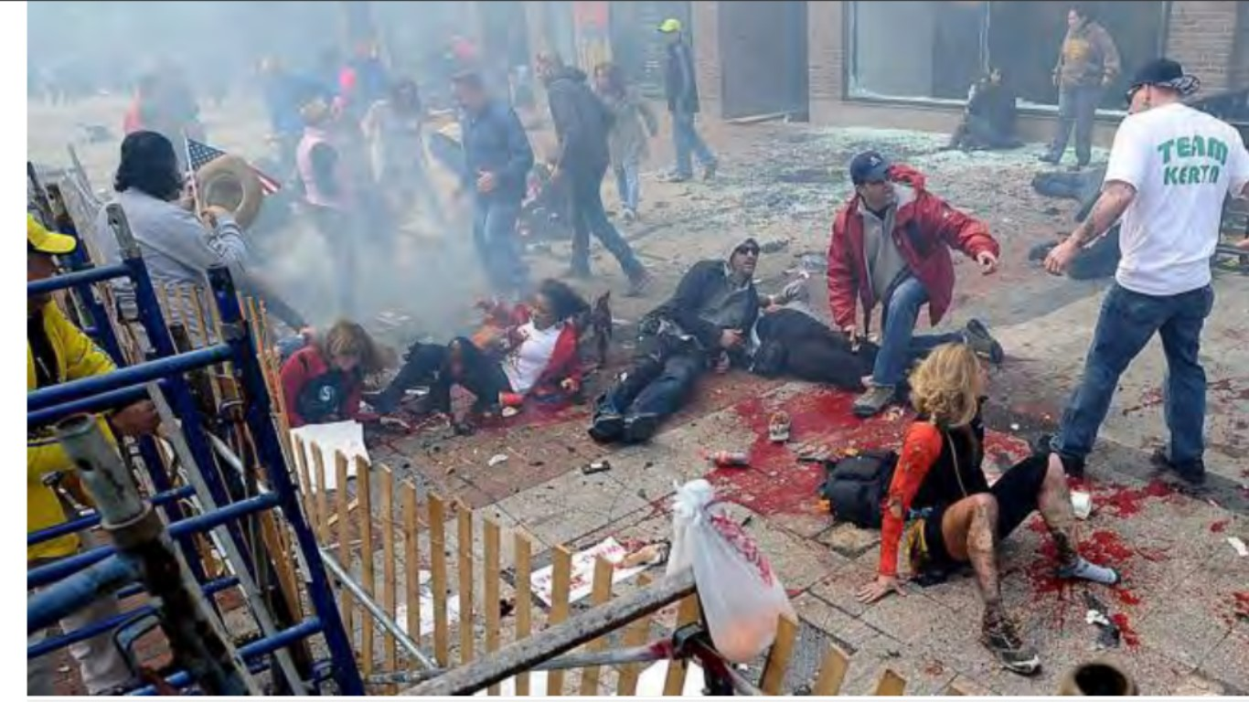
Types of Mass Casualty incidents 4 to 400 Injured
Highway Accidents
Air Crashes
Major Fires
Train Derailments
Building Collapses
Explosions
Terrorist Attacks
Active Shooter
Hazardous Materials Releases
Earthquakes
Tornadoes
Hurricanes

Slide 3
Local Hospital Capabilities
Think about Time of Day
What type of injuries are they capable to handle in house
How many surgeons are on call
How many surgical crews are on duty Vs On Call
Bed / Staff capability
ED Staffing (How long to get more staff called in)
Do Not Create a second Mass Casualty Scene

Slide 4
Know your EMS Box Card
99-1-3
How many ambulances come on each box and from WHERE?
What resources come with each box?
Send Critical Patients out by Helicopter if possible

Slide 5
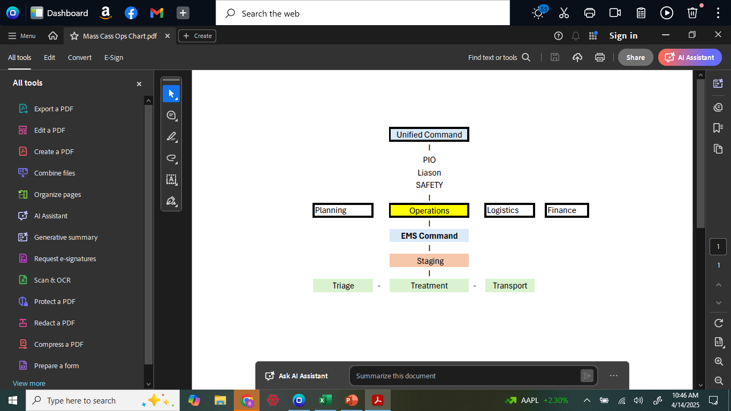

Slide 6

EMS Command
First arriving EMS Trained Responder

Slide 7

Staging Group Supervisor

Slide 8

How to set up a staging area
LAW
Fire
BUS
Ambulances
Staging Managers
Exit
Exit

Slide 9

Triage Group Supervisor

Slide 10
Law Enforcement Triage
Walking wounded….Green
Everyone else is Red

Slide 11
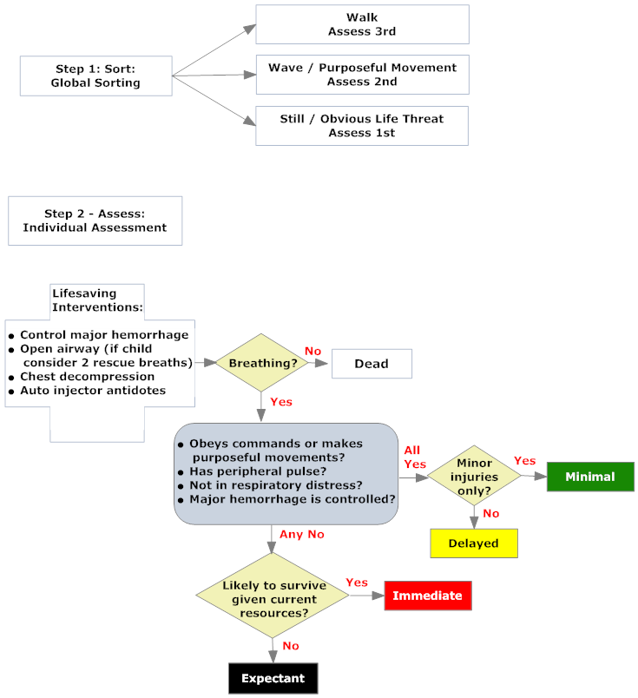

Slide 12
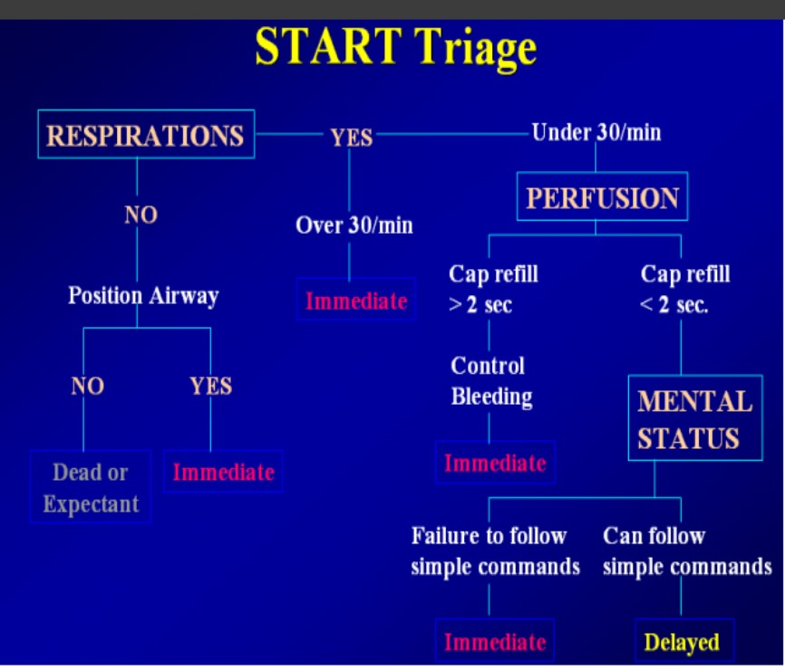

Slide 13
START Triage
Walking Wounded > Green…Must be re-triaged
R..Respirations over 30
P..Radial Pulse
M..Can Follow commands

Slide 14
Treatment Group Supervisor
Red
Yellow
Green
Grey

Slide 15

Transport Group Supervisor

Slide 16
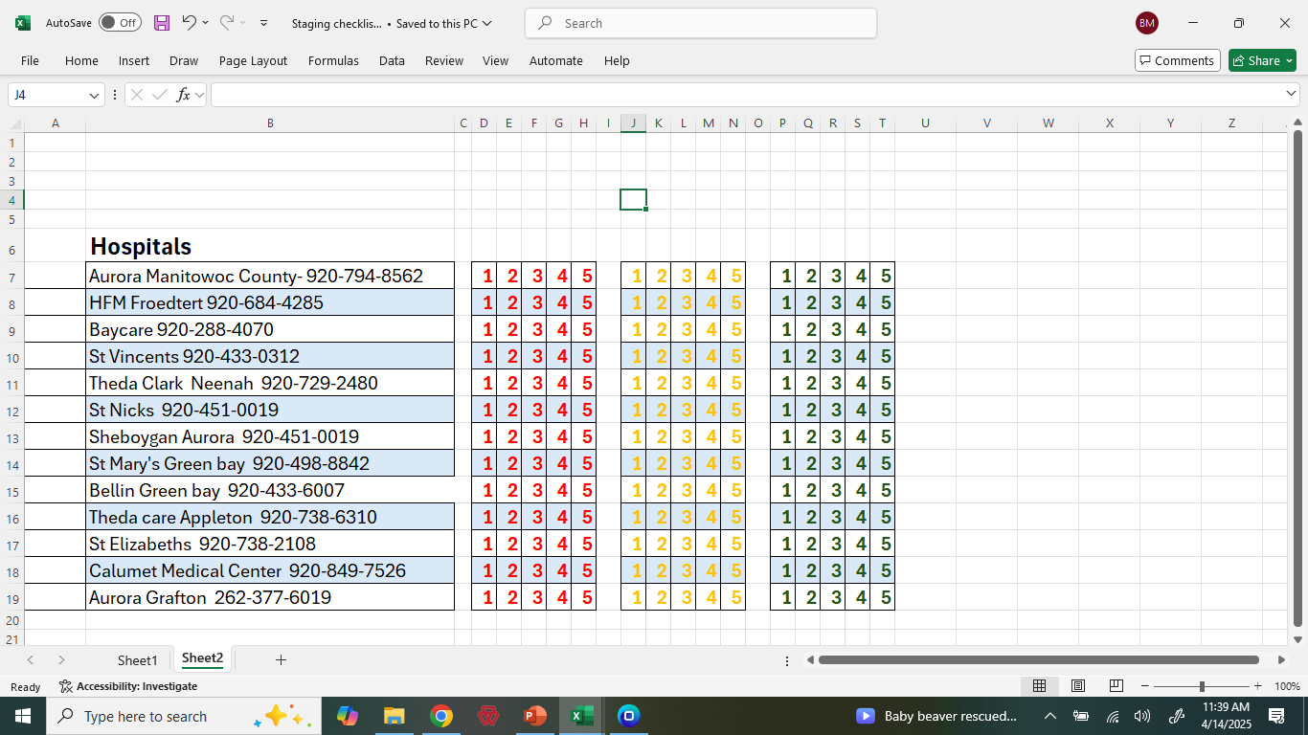

Slide 17

Other Resources
Hospitals-EM Resource
EMS>Hospitals-EM Track
Theda Star – Dispatch
Mabas Coordinator
HERC Coordinator

